Slide 1
Equations and their graphs
Graphical representations

Slide 2
How our teaching resources are designed for the classroom

Slide 3
I can recognise the determining features of the shape of a graph from its equation.

Slide 4
The relationship between two variables is linear if, when plotted on a pair of axes, a straight line is formed.
The gradient is a measure of how steep a line is.
An intercept is the coordinate where a line or curve meets a given axis.

Slide 5

Equations and their graphs
Reviewing features of linear graphs
Sketching linear graphs

Slide 6
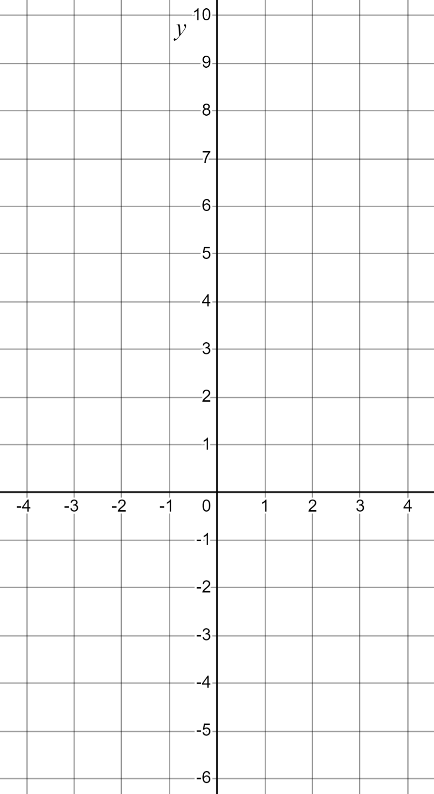
Reviewing features of linear graphs
We can plot the graphs of equations. One method is to populate a table of values.
y = 2x
x | −3 | −2 | −1 | 0 | 1 | 2 | 3
y
y = x²
x | −3 | −2 | −1 | 0 | 1 | 2 | 3
y

Slide 7
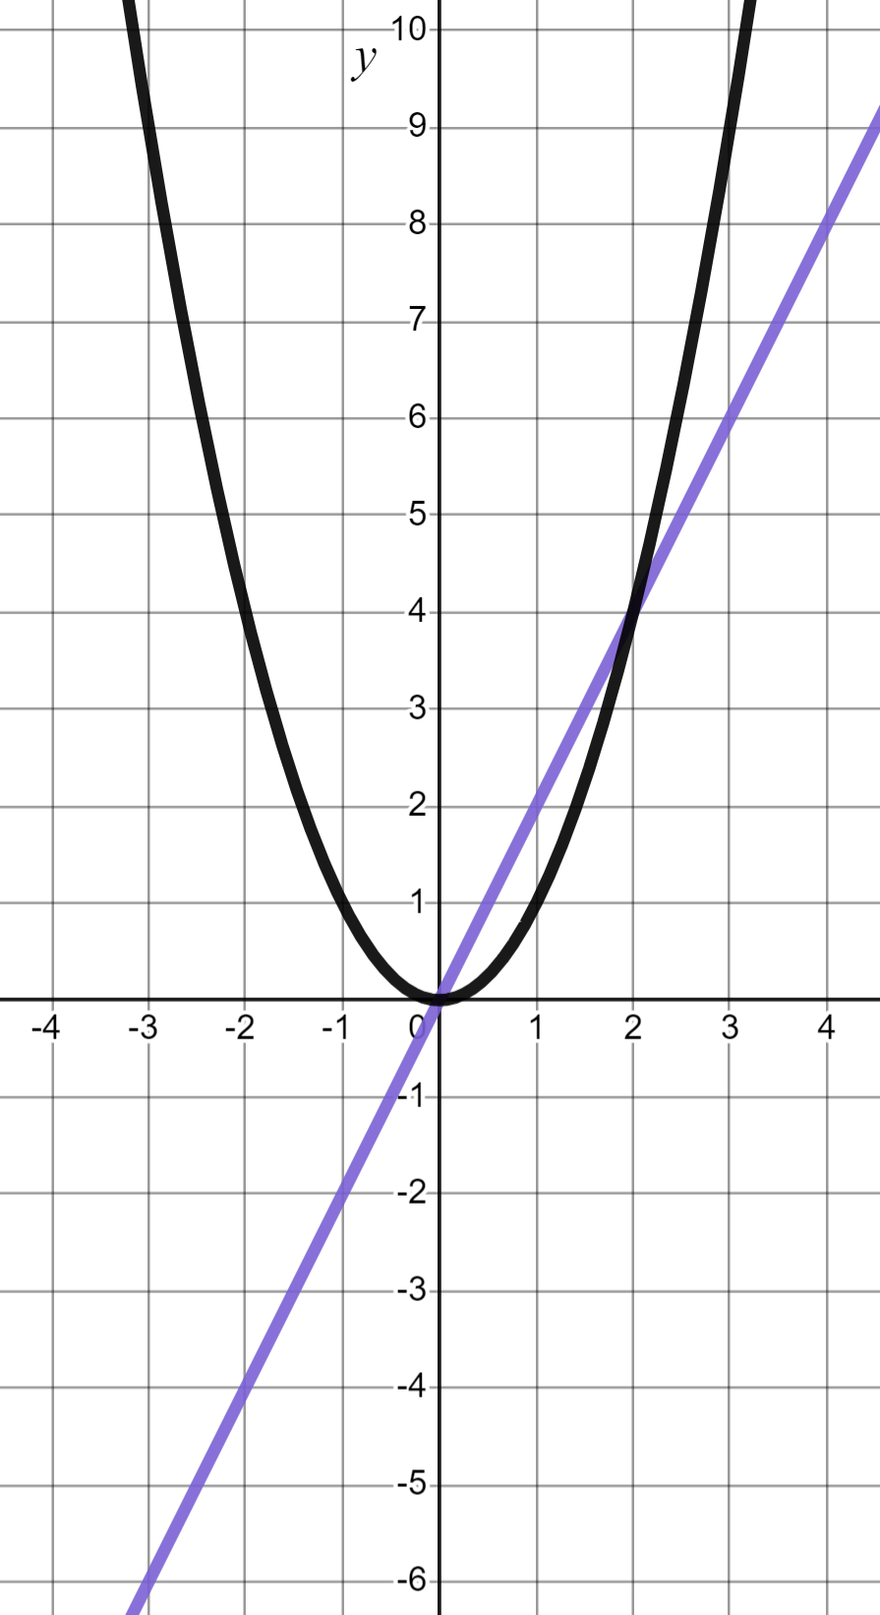
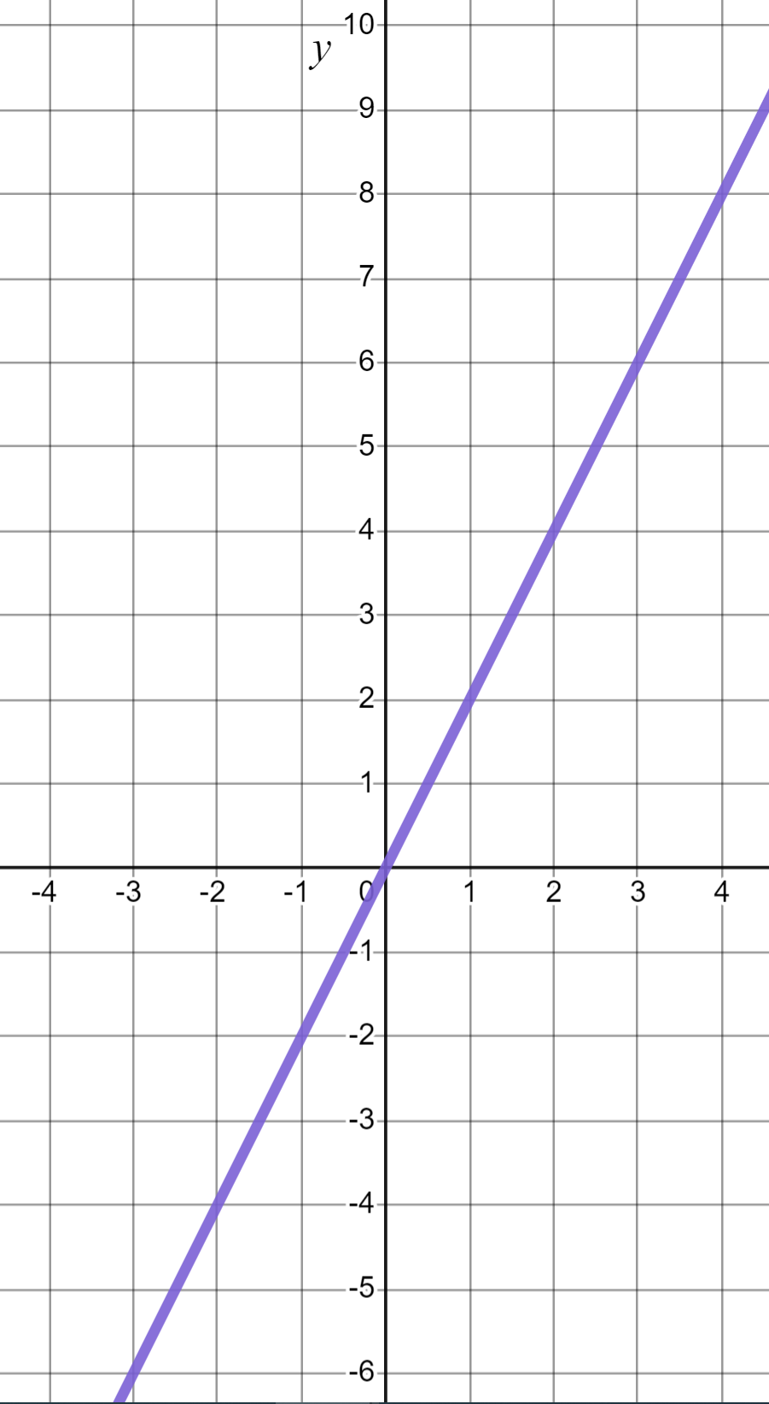
Reviewing features of linear graphs
We can plot the graphs of equations. One method is to populate a table of values.
y = x²
y = 2x
x | −3 | −2 | −1 | 0 | 1 | 2 | 3
y | −6 | −4 | −2 | 0 | 2 | 4 | 6
Linear equation, linear graph.
y = x²
y = 2x
x | −3 | −2 | −1 | 0 | 1 | 2 | 3
y
y = 2x
x | −3 | −2 | −1 | 0 | 1 | 2 | 3
y | 9 | 4 | 1 | 0 | 1 | 4 | 9
Quadratic equation, non-linear graph (parabola).

Slide 8
Reviewing features of linear graphs
Key features of the equations affect the shape of the graph that is formed.
y = x²
y = 2x
x | −3 | −2 | −1 | 0 | 1 | 2 | 3
y | −6 | −4 | −2 | 0 | 2 | 4 | 6
Linear equation, linear graph.
y = x²
x | −3 | −2 | −1 | 0 | 1 | 2 | 3
y | 9 | 4 | 1 | 0 | 1 | 4 | 9
y = 2x
Quadratic equation, non-linear graph (parabola).

Slide 9
Reviewing features of linear graphs
Key features of the equations affect the shape of the graph that is formed.
y = x²
y = 2x
An x exponent of 1 gave us a linear graph.
Linear equation, linear graph.
y = x²
An x exponent that is not 1 gave us a non-linear graph.
y = 2x
Quadratic equation, non-linear graph (parabola).

Slide 10


Reviewing features of linear graphs
Which of these equations will form a linear graph?
y = 3x + 2
x exponent of 1. Linear equation, linear graph.
y = x³ + 2
x exponent not 1. Non-linear graph.
y = 3x − 2
x exponent of 1. Linear equation, linear graph.

Slide 11
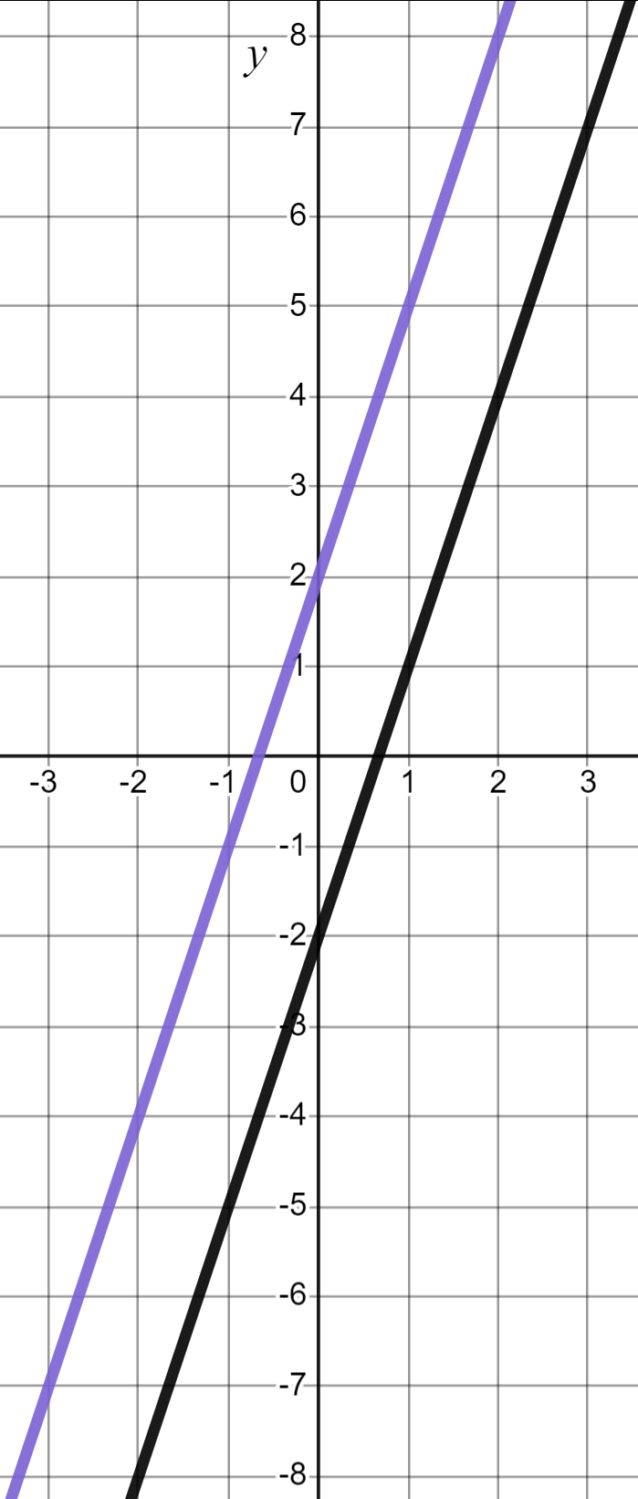
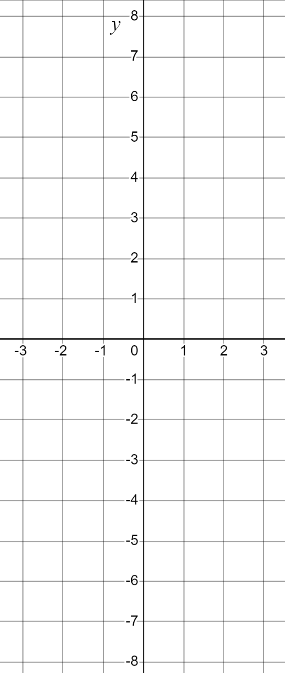
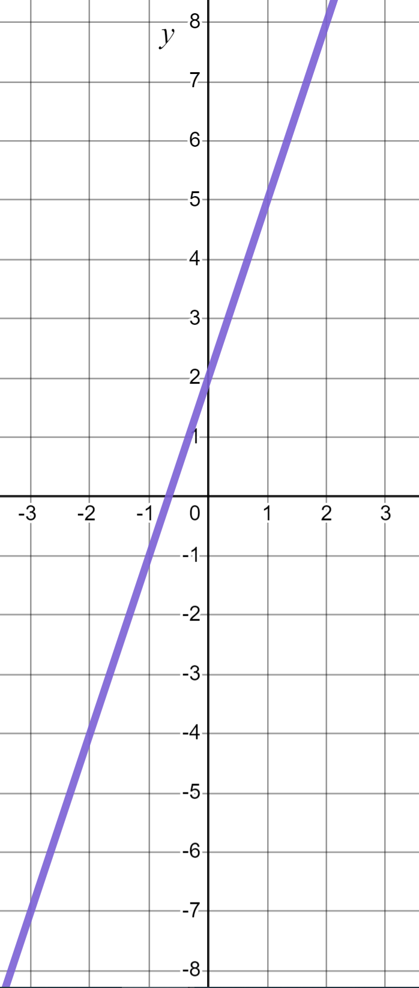
Reviewing features of linear graphs
How will these two linear graphs look the same/different?
y = 3x + 2
x | −2 | −1 | 0 | 1 | 2
y
x | −2 | −1 | 0 | 1 | 2
y | −4 | −1 | 2 | 5 | 8
y = 3x + 2
y = 3x − 2
x | −2 | −1 | 0 | 1 | 2
y | −8 | −5 | −2 | 1 | 4
x | −2 | −1 | 0 | 1 | 2
y
y = 3x − 2

Slide 12
Reviewing features of linear graphs
How will these two linear graphs look the same/different?
y = 3x + 2
y = 3x + 2
Both graphs have the same gradient
y = 3x − 2
y = 3x − 2

Slide 13
Reviewing features of linear graphs
How will these two linear graphs look the same/different?
y = 3x + 2
y = 3x + 2
Both graphs have the same gradient
y = 3x − 2
The graphs have different y-intercepts
y = 3x − 2
Gradient and y-intercept are two key features of a linear graph.

Slide 14
Reviewing features of linear graphs
y = 3x + 2, a linear graph with gradient 3 and y-intercept (0, 2)
x | −2 | −1 | 0 | 1 | 2
y
x | −2 | −1 | 0 | 1 | 2
y | −4 | −1 | 2 | 5 | 8
y = 3x + 2
+3
+3
+3
+3
+3
+3
A gradient of 3 means a change of 3 in y for every change of 1 in x
+3
It is visible not just on the graph but in the table of values and the equation itself.

Slide 15
Reviewing features of linear graphs
y = 3x + 2, a linear graph with gradient 3 and y-intercept (0, 2)
x | −2 | −1 | 0 | 1 | 2
y
x | −2 | −1 | 0 | 1 | 2
y | −4 | −1 | 2 | 5 | 8
y = 3x + 2
✖
A y-intercept (0, 2) means the graph cuts the y-axis at this coordinate.
It is visible not just on the graph but in the table of values and the equation itself.

Slide 16
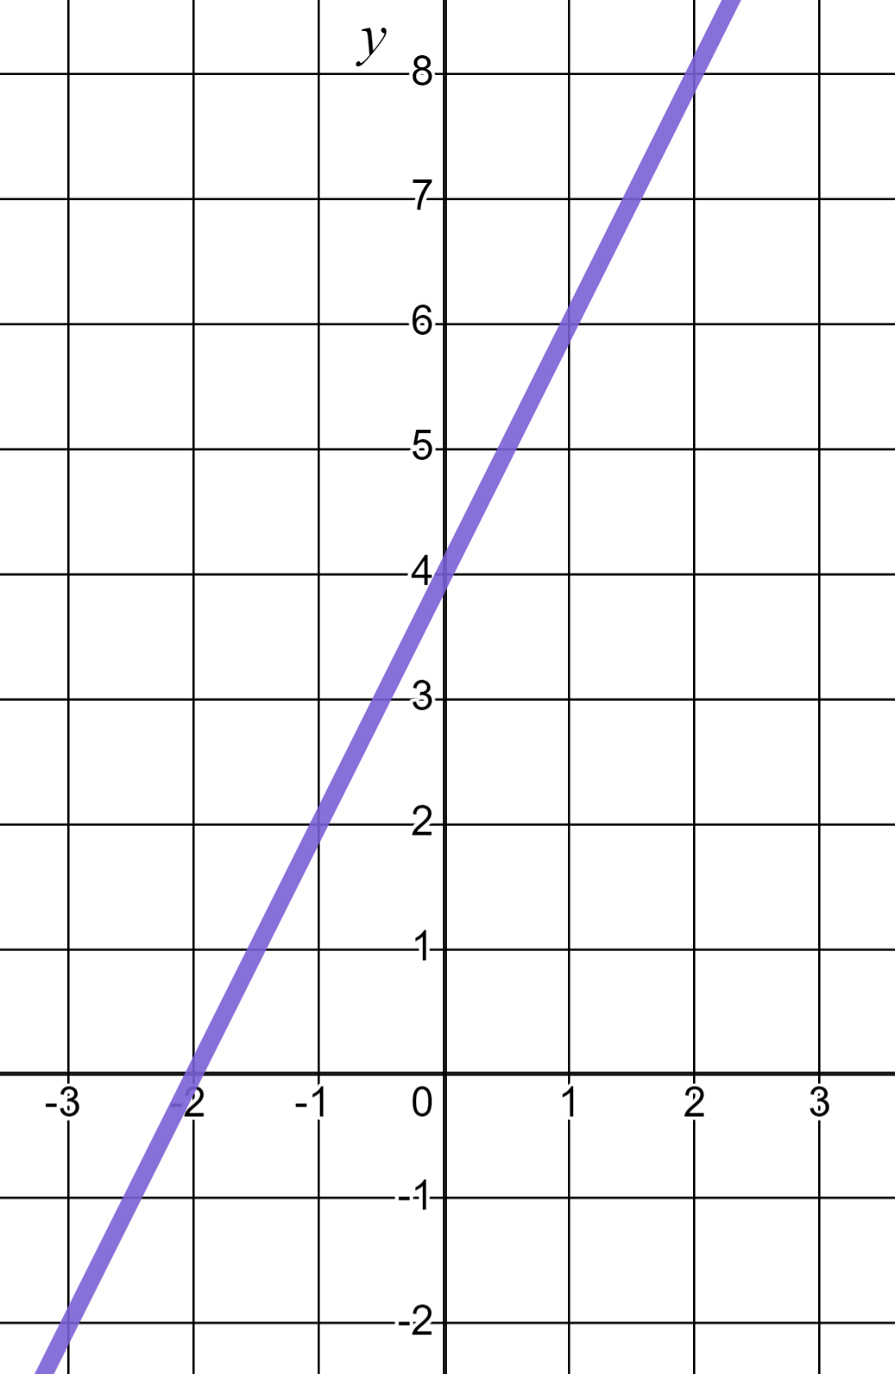
Reviewing features of linear graphs
Identify the gradient of this linear graph.
+2
−2
+2
A change of 2 in y for every change of +1 in x
2
4

Slide 17
Reviewing features of linear graphs
Identify the y-intercept of the same graph.
(0, 4)
The line cuts the y-axis at (0, 4)
✖
(−2, 0)
(4, 0)

Slide 18
Reviewing features of linear graphs
A gradient of 2 and a y-intercept of (0, 4) is unique to this line and no other line.
+2
A gradient of 2 and a y-intercept of (0, 4) makes this line y = 2x + 4
+2
✖
In the form y = mx + c it is the value of m which defines our gradient and the value of c which defines our y-intercept.

Slide 19
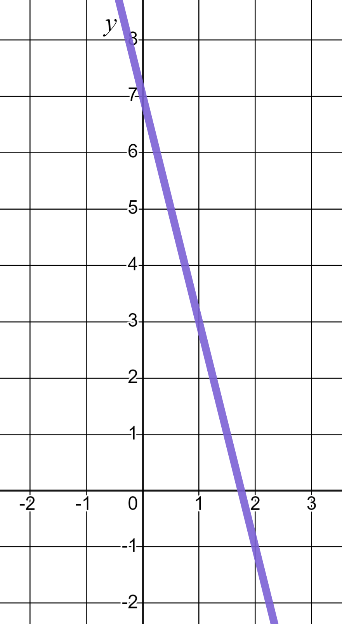
Reviewing features of linear graphs
Gradient:
Gradient: −4
✖
y-intercept:
y-intercept: (0, 7)
The line y = −4x + 7
y = 7 − 4x
In the form y = mx + c it is the value of m which defines our gradient and the value of c which defines our y-intercept.
−4

Slide 20
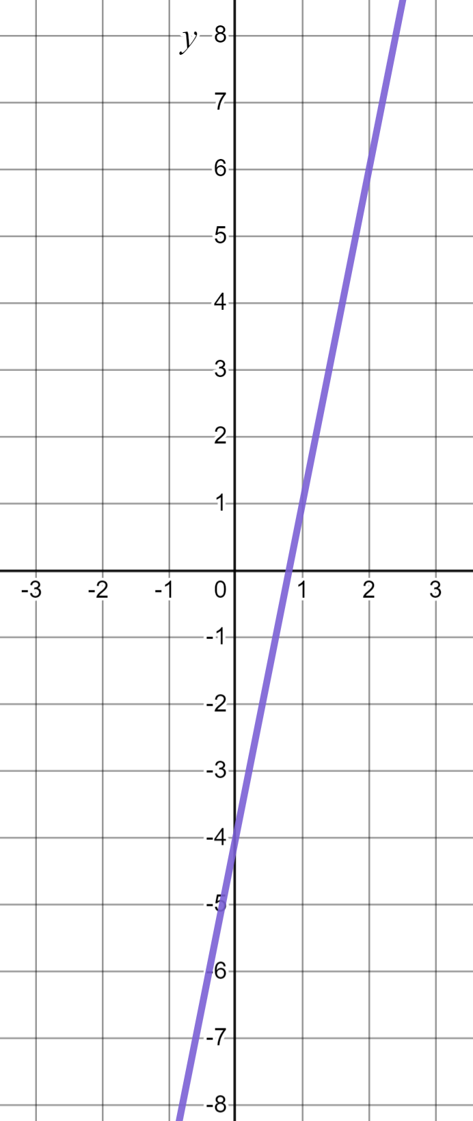
Reviewing features of linear graphs
This line has gradient of 5 and a y-intercept of (0, −4). What is the line?
y = −4x + 5
y = 5x + 4
y = 5x − 4
y = 5x − 4
Gradient
y-intercept

Slide 21
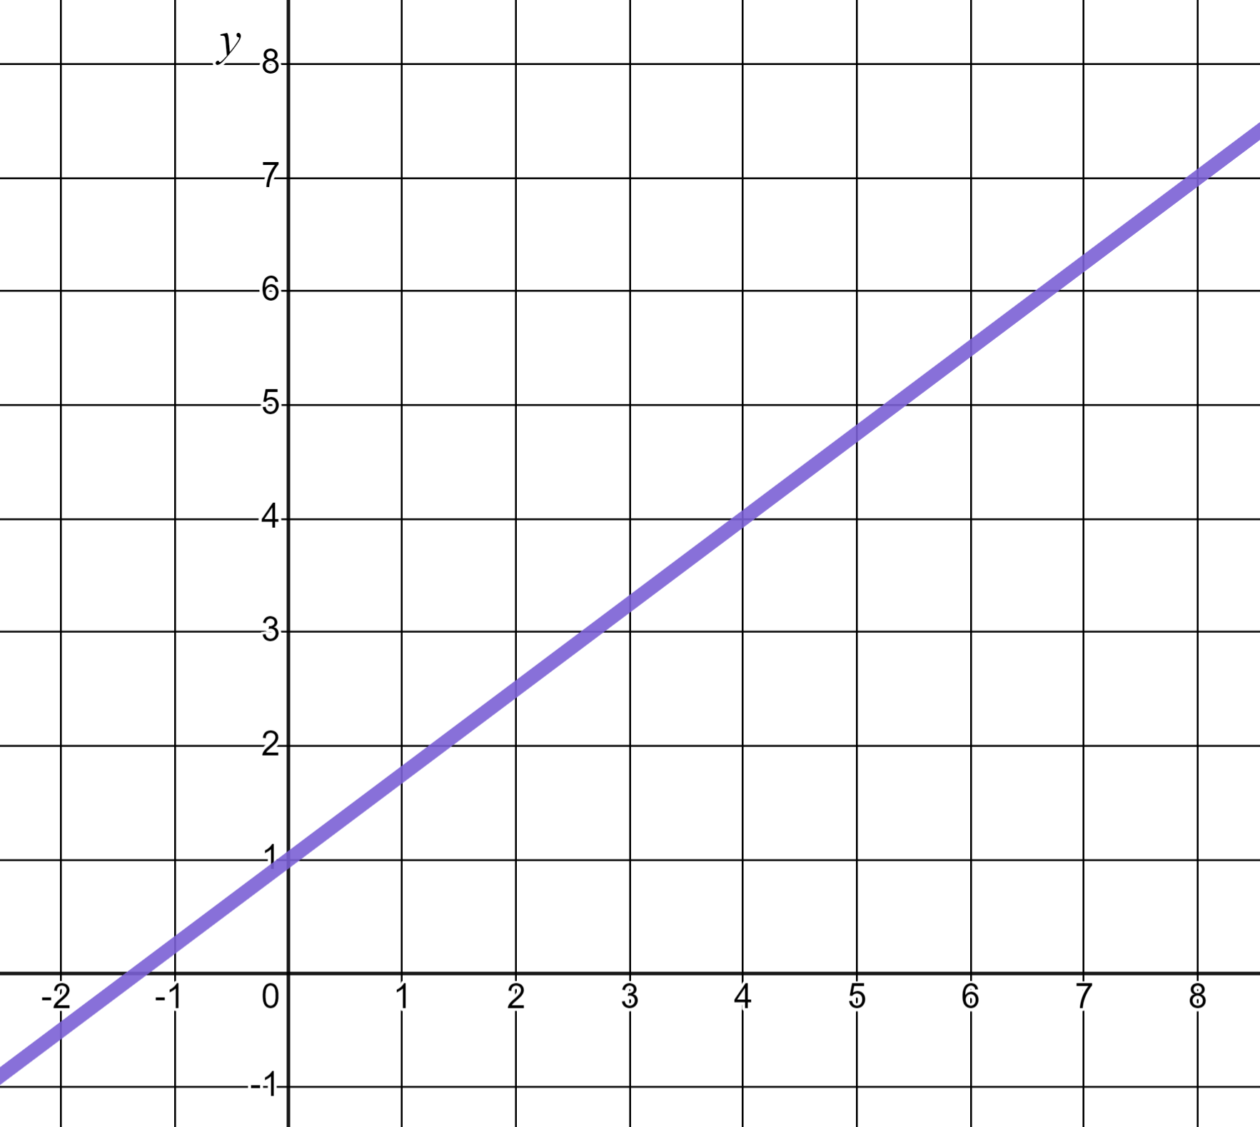
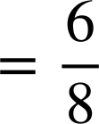
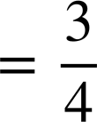
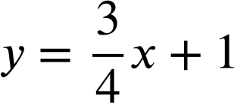
Reviewing features of linear graphs
The gradient won’t always be an integer. The gradient is calculated by finding the rate of change in the y-direction with respect to the positive x-direction.
✖
Any two known coordinates enables us to find the gradient.
+6
Change in y
✖
Gradient =
+8
Change in x
The line

Slide 22
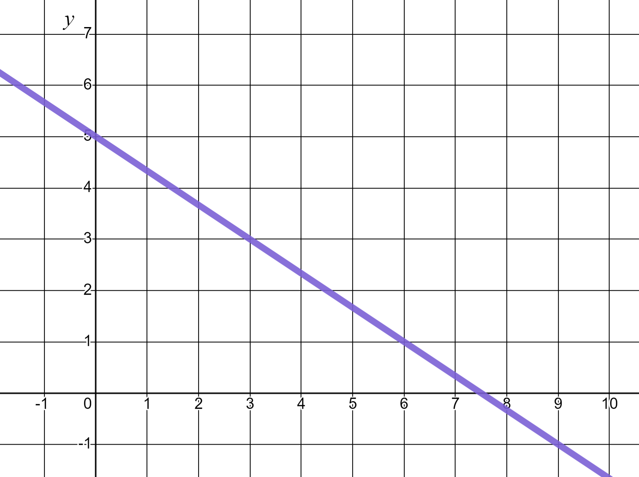



Reviewing features of linear graphs
Identify the gradient of this linear graph.
Change in y
Change in x
3
With respect to the positive x-direction.
−2

Slide 23
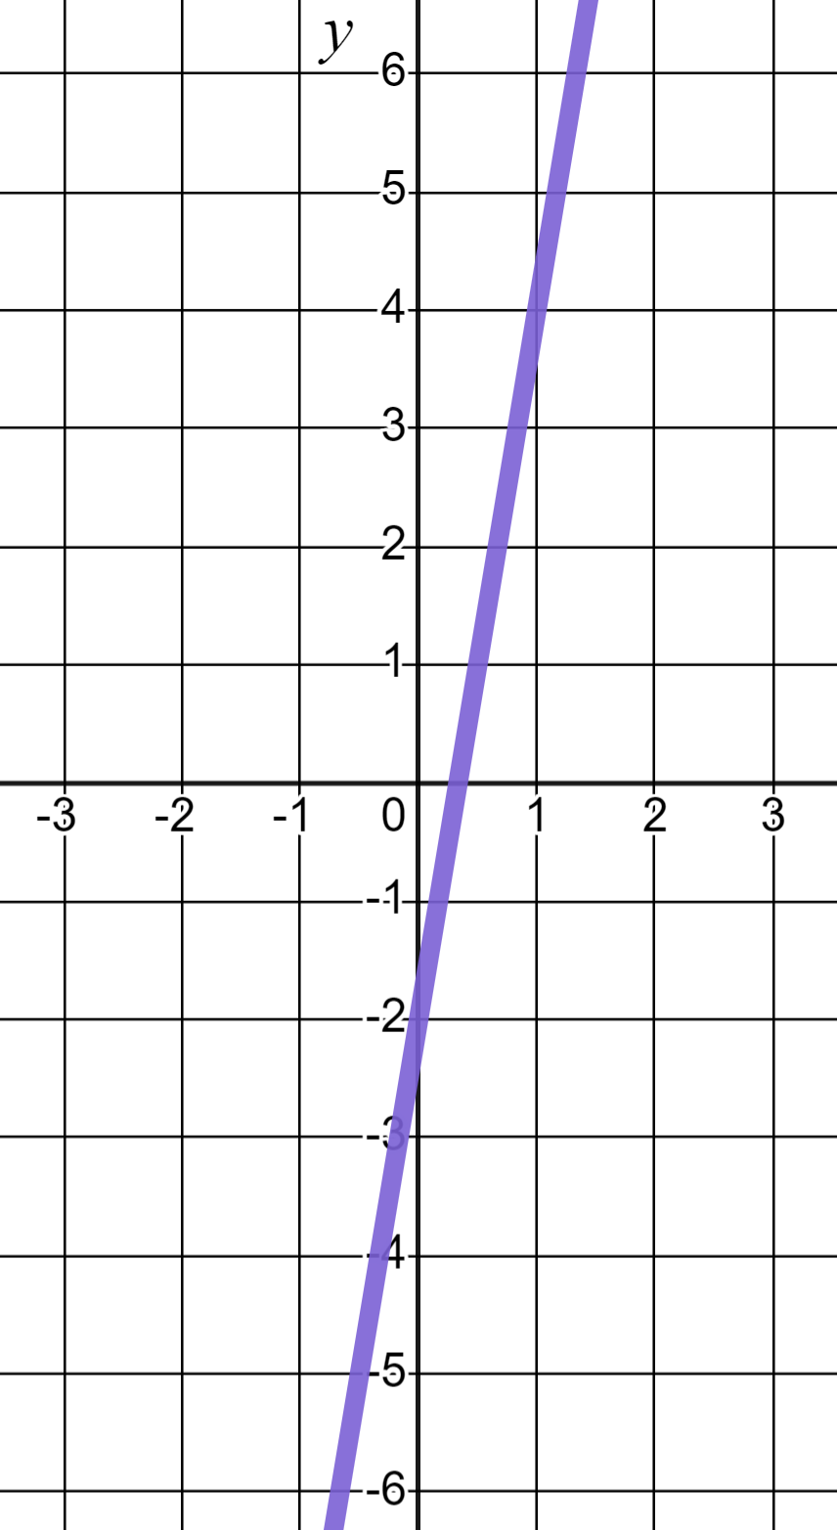
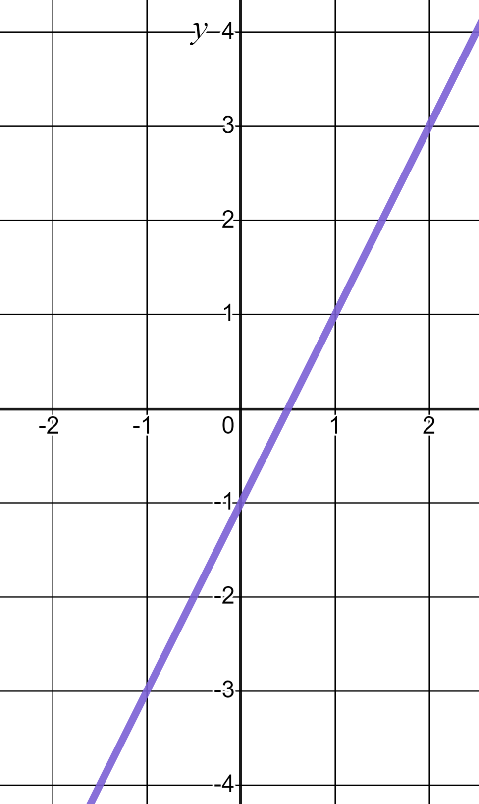
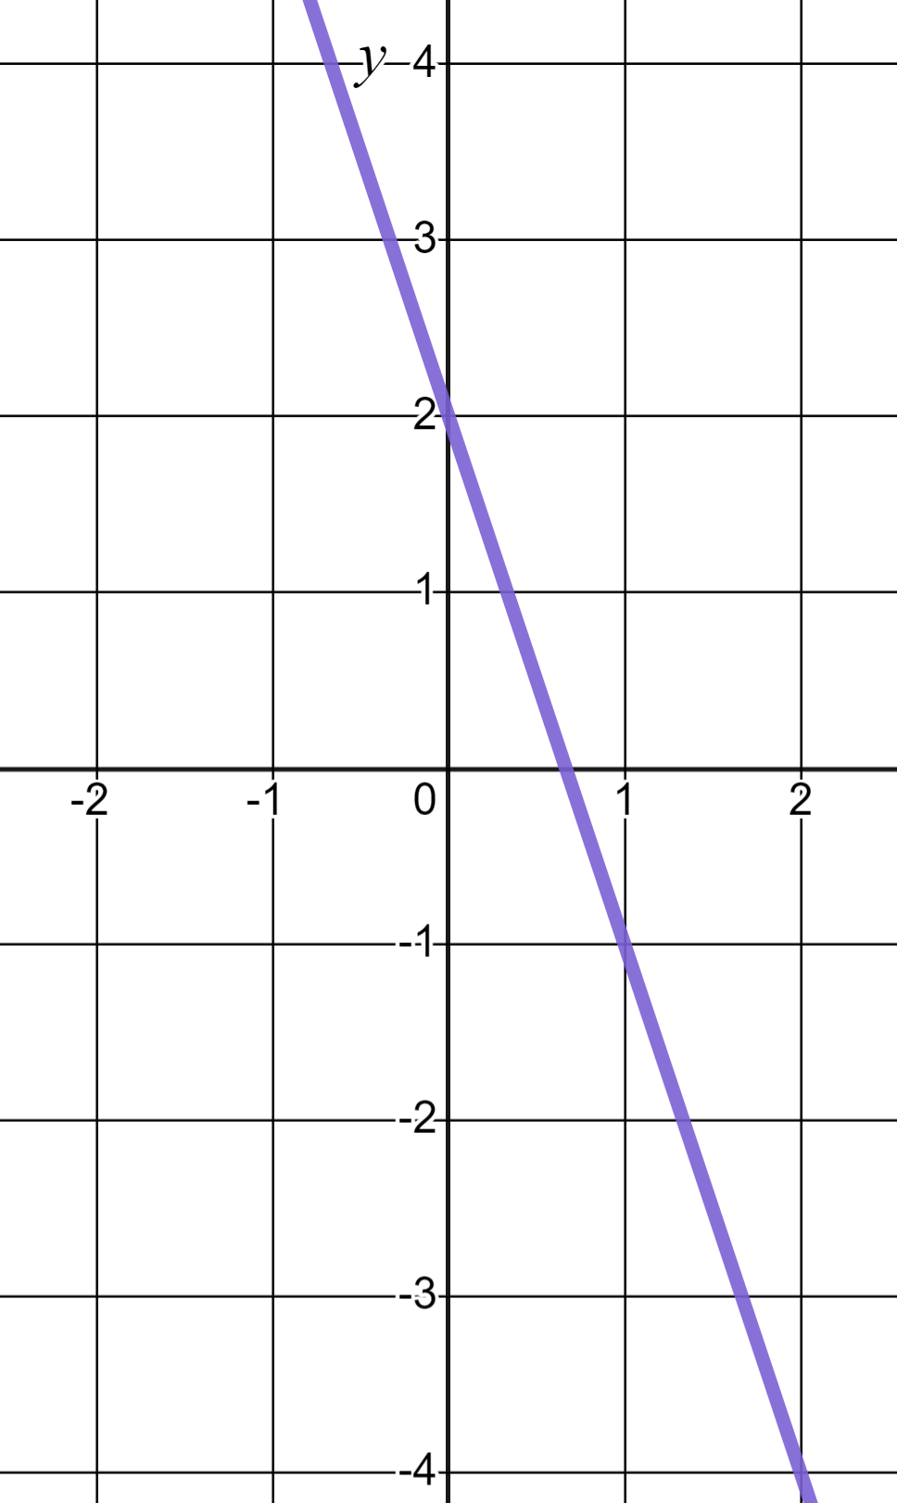
Reviewing features of linear graphs
1) Gradient of 6 and a y-intercept of (0, −2) is a description unique to graph (a). Write descriptions for b) and c)
a)
b)
c)

Slide 24
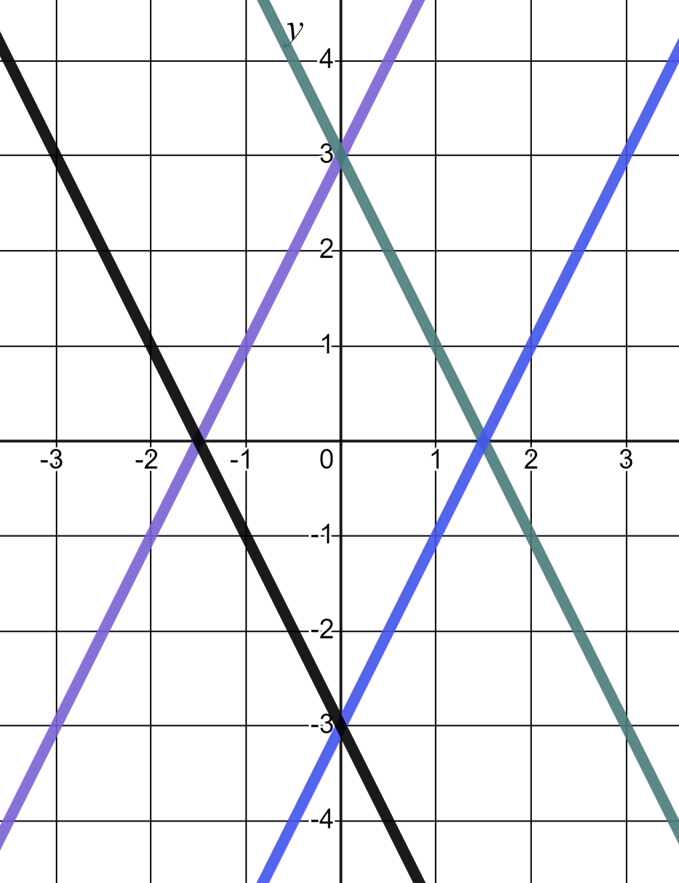
Reviewing features of linear graphs
2) Match the linear equations to their respective lines.
a) y = 2x + 3
b) y = 3 − 2x
c) y = −3 − 2x
d) y = 2x − 3

Slide 25
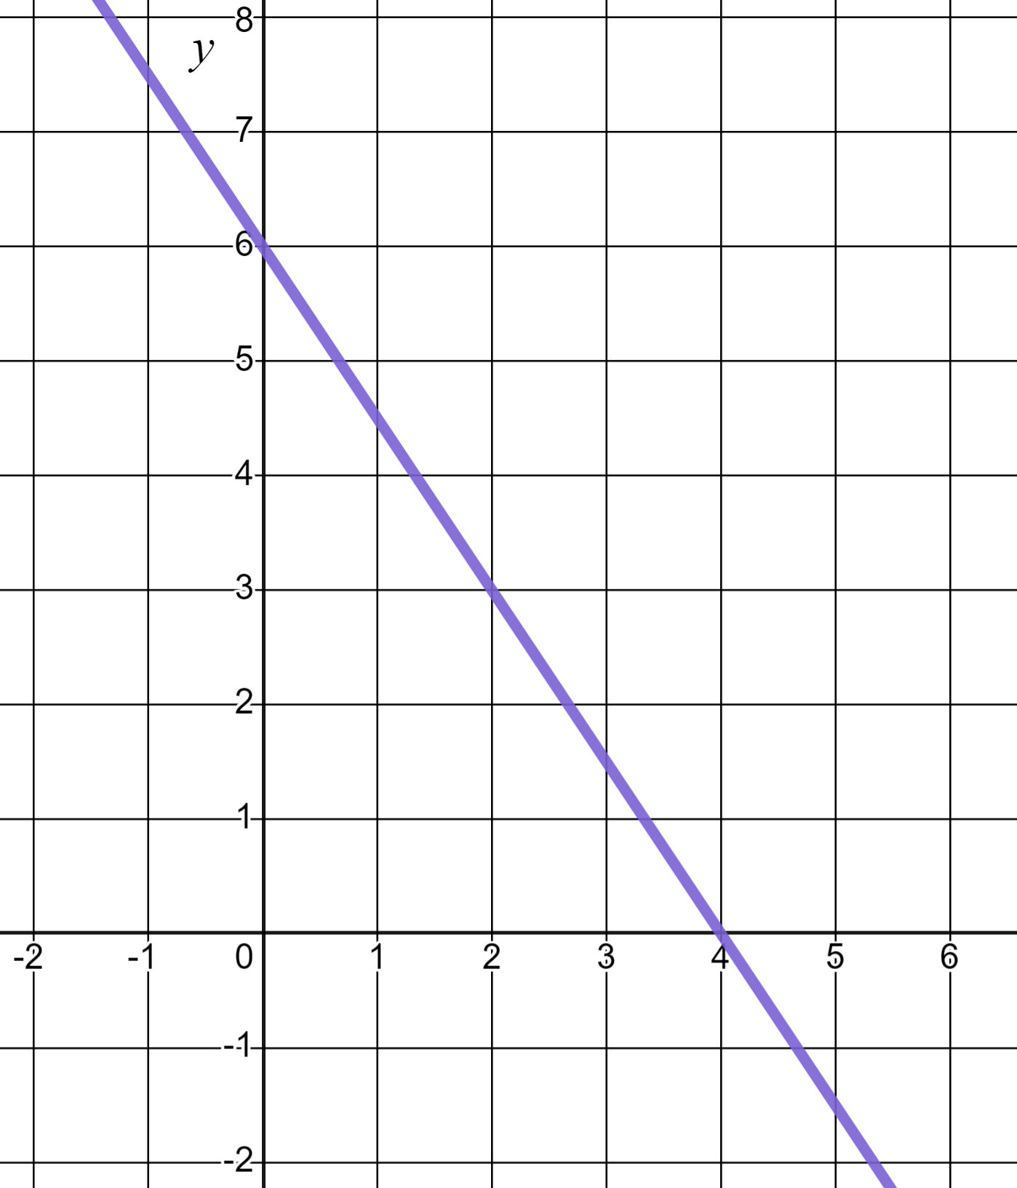

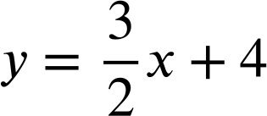

Reviewing features of linear graphs
3) Laura is writing the equation of this linear graph.
2
I see a change of 3 in y and a change of 2 in x and and intercept of 4 so this is the line
3
✖
Write at least two sentences to explain Laura’s errors to her. You may choose to annotate the graph in your explanation.

Slide 26
Reviewing features of linear graphs
1) Gradient of 6 and a y-intercept of (0, −2) is a description unique to graph (a). Write descriptions for b) and c)
a)
b)
c)

Slide 27
Reviewing features of linear graphs
1) Gradient of 6 and a y-intercept of (0, −2) is a description unique to graph (a). Write descriptions for b) and c)
b)
c)
b) Gradient of 2 and a y-intercept of (0, −1)
c) Gradient of −3 and a y-intercept of (0, 2)

Slide 28
Reviewing features of linear graphs
2) Match the linear equations to their respective lines.
a) y = 2x + 3
c) y = −3 − 2x
d) y = 2x − 3
b) y = 3 − 2x
c) y = −3 − 2x
d) y = 2x − 3
a) y = 2x + 3
b) y = 3 − 2x

Slide 29
Reviewing features of linear graphs
3) Laura is writing the equation of this linear graph.
2
I see a change of 3 in y and a change of 2 in x and and intercept of 4 so this is the line
3
✖
Write at least two sentences to explain Laura’s errors to her. You may choose to annotate the graph in your explanation.

Slide 30
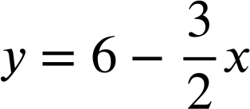
Reviewing features of linear graphs
3)
I see a change of 3 in y and a change of 2 in x and and intercept of 4 so this is the line
2
2
✖
3
−3
The gradient is the change in y divided by the change in x but with respect to the positive x-direction.
✖
✖
In the form y = mx + c the c relates to the y-intercept, not that of the x axis.
This is the line

Slide 31
Equations and their graphs
Reviewing features of linear graphs
Sketching linear graphs

Slide 32
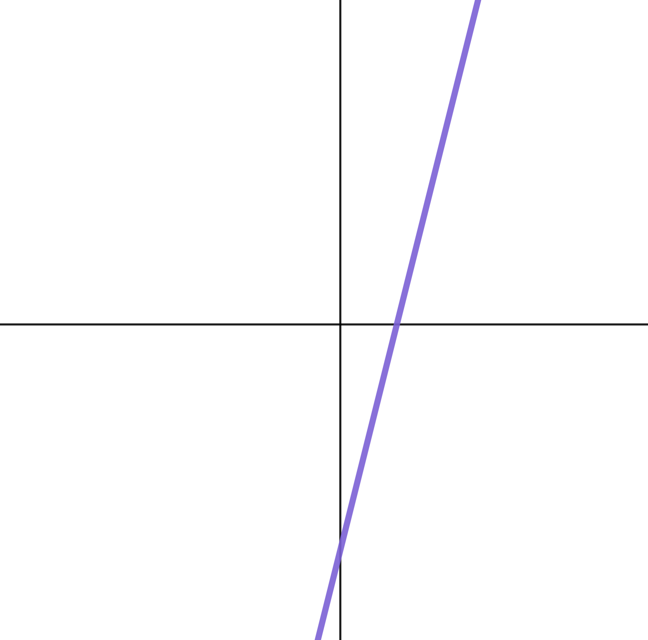

Sketching linear graphs
Having a good understanding of y = mx + c enables us to quickly sketch linear graphs.
y
y = 4x − 5
Gradient of 4
y-intercept of (0, −5)
x
y-intercept in the negatives.
Steep, positive gradient.
(0,−5)
✖
When sketching graphs we label key features.

Slide 33
Sketching linear graphs
A sketch is not 100% accurate. It is just an approximate representation that we draw to help us visualise or solve problems.
y
y = 4x − 5
Gradient of 4
y-intercept of (0, −5)
x
y-intercept in the negatives.
Steep, positive gradient.
(0,−5)
✖
When sketching graphs we label key features.

Slide 34
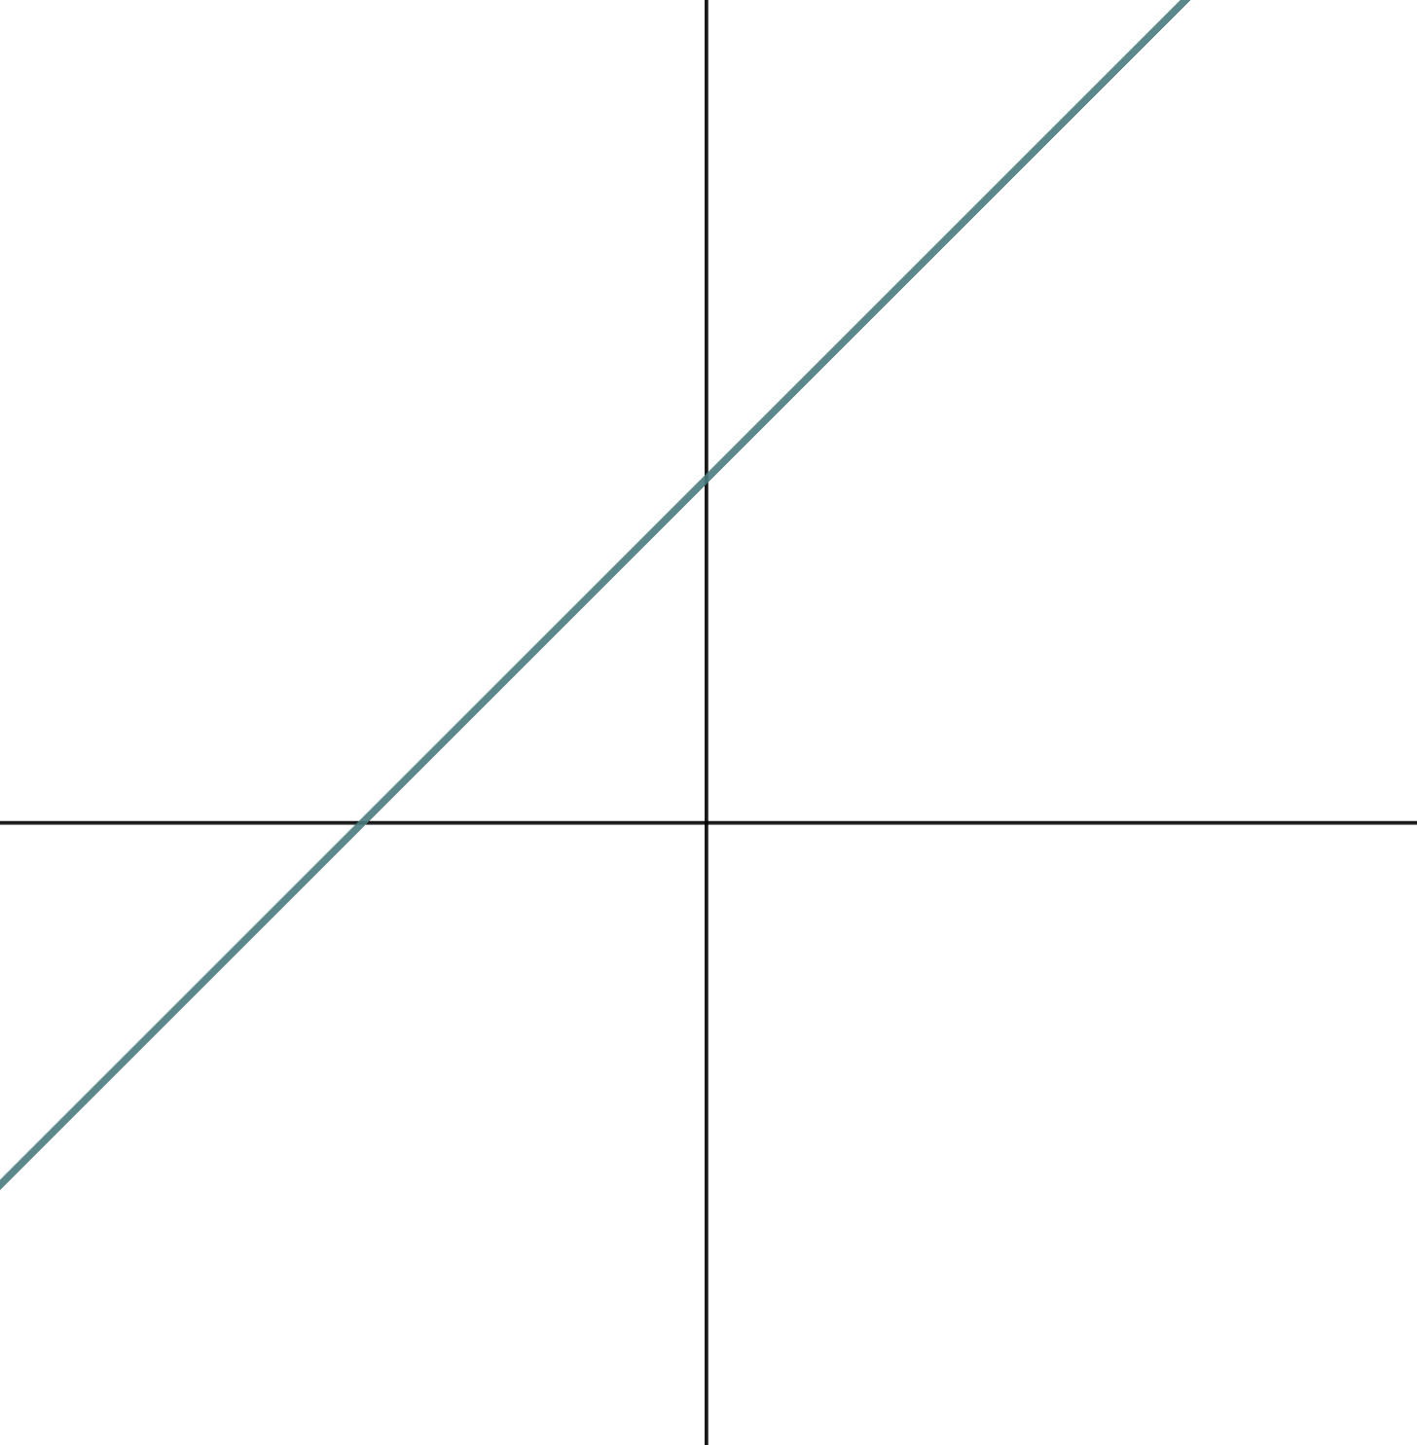


Sketching linear graphs
Jun and Sofia are discussing this linear graph.
y
This looks perfectly diagonal, that’s a gradient of 1. That y-intercept looks about (0, 5). I think this is the line y = x + 5
It might be y = x + 5 but it could be anything! We have to be careful!
x
Who do you agree with?

Slide 35
Sketching linear graphs
Jun and Sofia are discussing this linear graph.
y
This looks perfectly diagonal, that’s a gradient of 1. That y-intercept looks about (0, 5). I think this is the line y = x + 5
Jun may be right but, we do not have enough information to be sure. The only thing we know is that the y-intercept has a positive y coordinate and that the gradient is positive. He had that right however, the scale on these axes could be anything.
x

Slide 36
Sketching linear graphs
Jun and Sofia are discussing this linear graph.
y
Sofia was right to issue caution over exact accuracy. However, she is wrong to say it could be ‘anything’. The y-intercept has a positive y coordinate and the gradient is positive.
It might be y = x + 5 but it could be anything! We have to be careful!
x

Slide 37
Sketching linear graphs
If we know one line, it can help us to know something about another.
y
If we knew this line was y = x + 5 …
(0, 5)
✖
…what do we know about this line?
x
Same y-intercept of (0, 5)
Gradient of 0 < m < 1

Slide 38
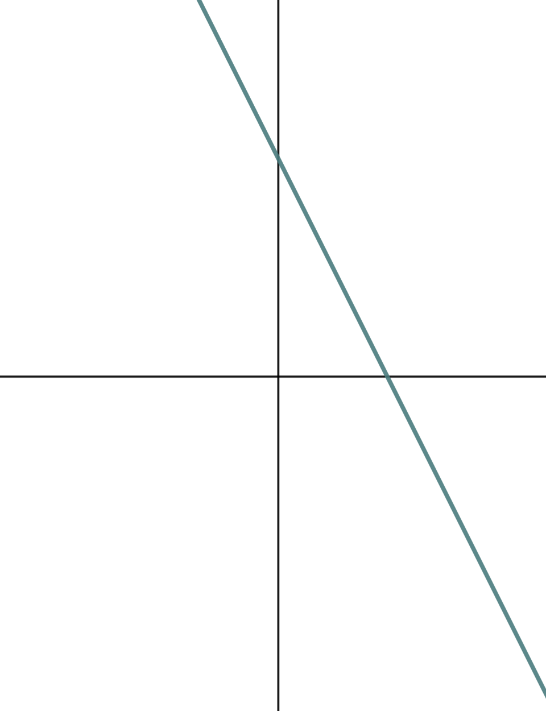
Sketching linear graphs
What could the equation of this line be?
y
Our line does not have a y-intercept (0, 5)
y = 5 − 3x
(0, 17)
✖
Our line does not have a y-intercept (0, 34)
y = 34 − 3x
x
y = 17 − 3x
Negative gradient, y-intercept (0, 17)
y = − 3x − 17
Our line does not have a y-intercept (0, −17)

Slide 39
Sketching linear graphs
What could the equation of this line be?
All four equations had a gradient −3 which this line could be but, only one had the correct y-intercept.
This is why we label sketches.
y
y = 5 − 3x
(0, 17)
✖
y = 34 − 3x
x
y = 17 − 3x
y = − 3x − 17

Slide 40

Sketching linear graphs
1) Sketch the lines y = 2x + 10, y = 5 − 4x, and y = 2x − 5 on the below axes.
y
x

Slide 41
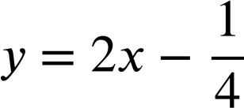
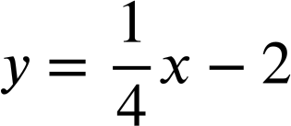
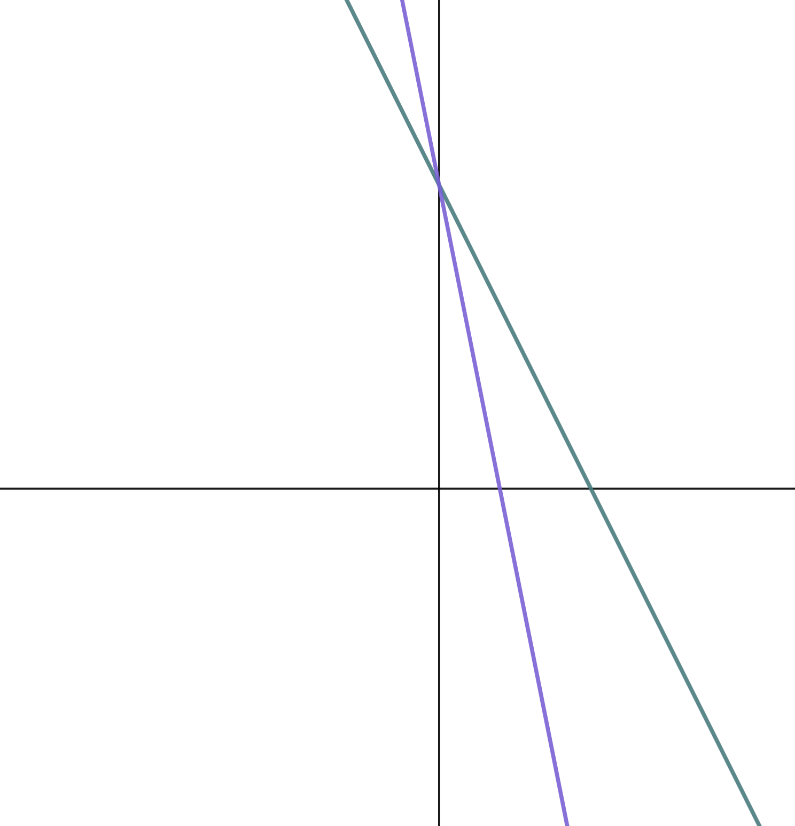
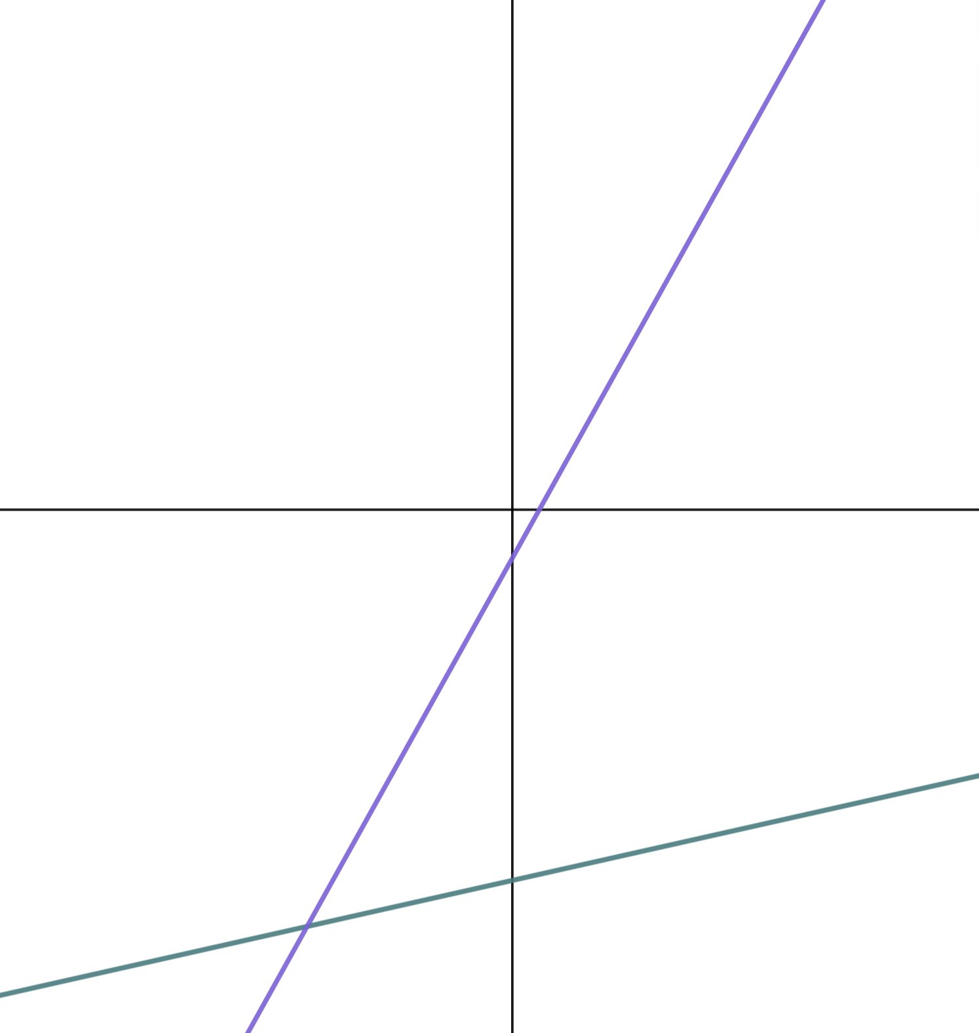
Sketching linear graphs
2) Match the linear equations to their respective lines.
a)
b) y = 18 − 2x
c) y = −5x + 18
d)
y
y
x
x

Slide 42
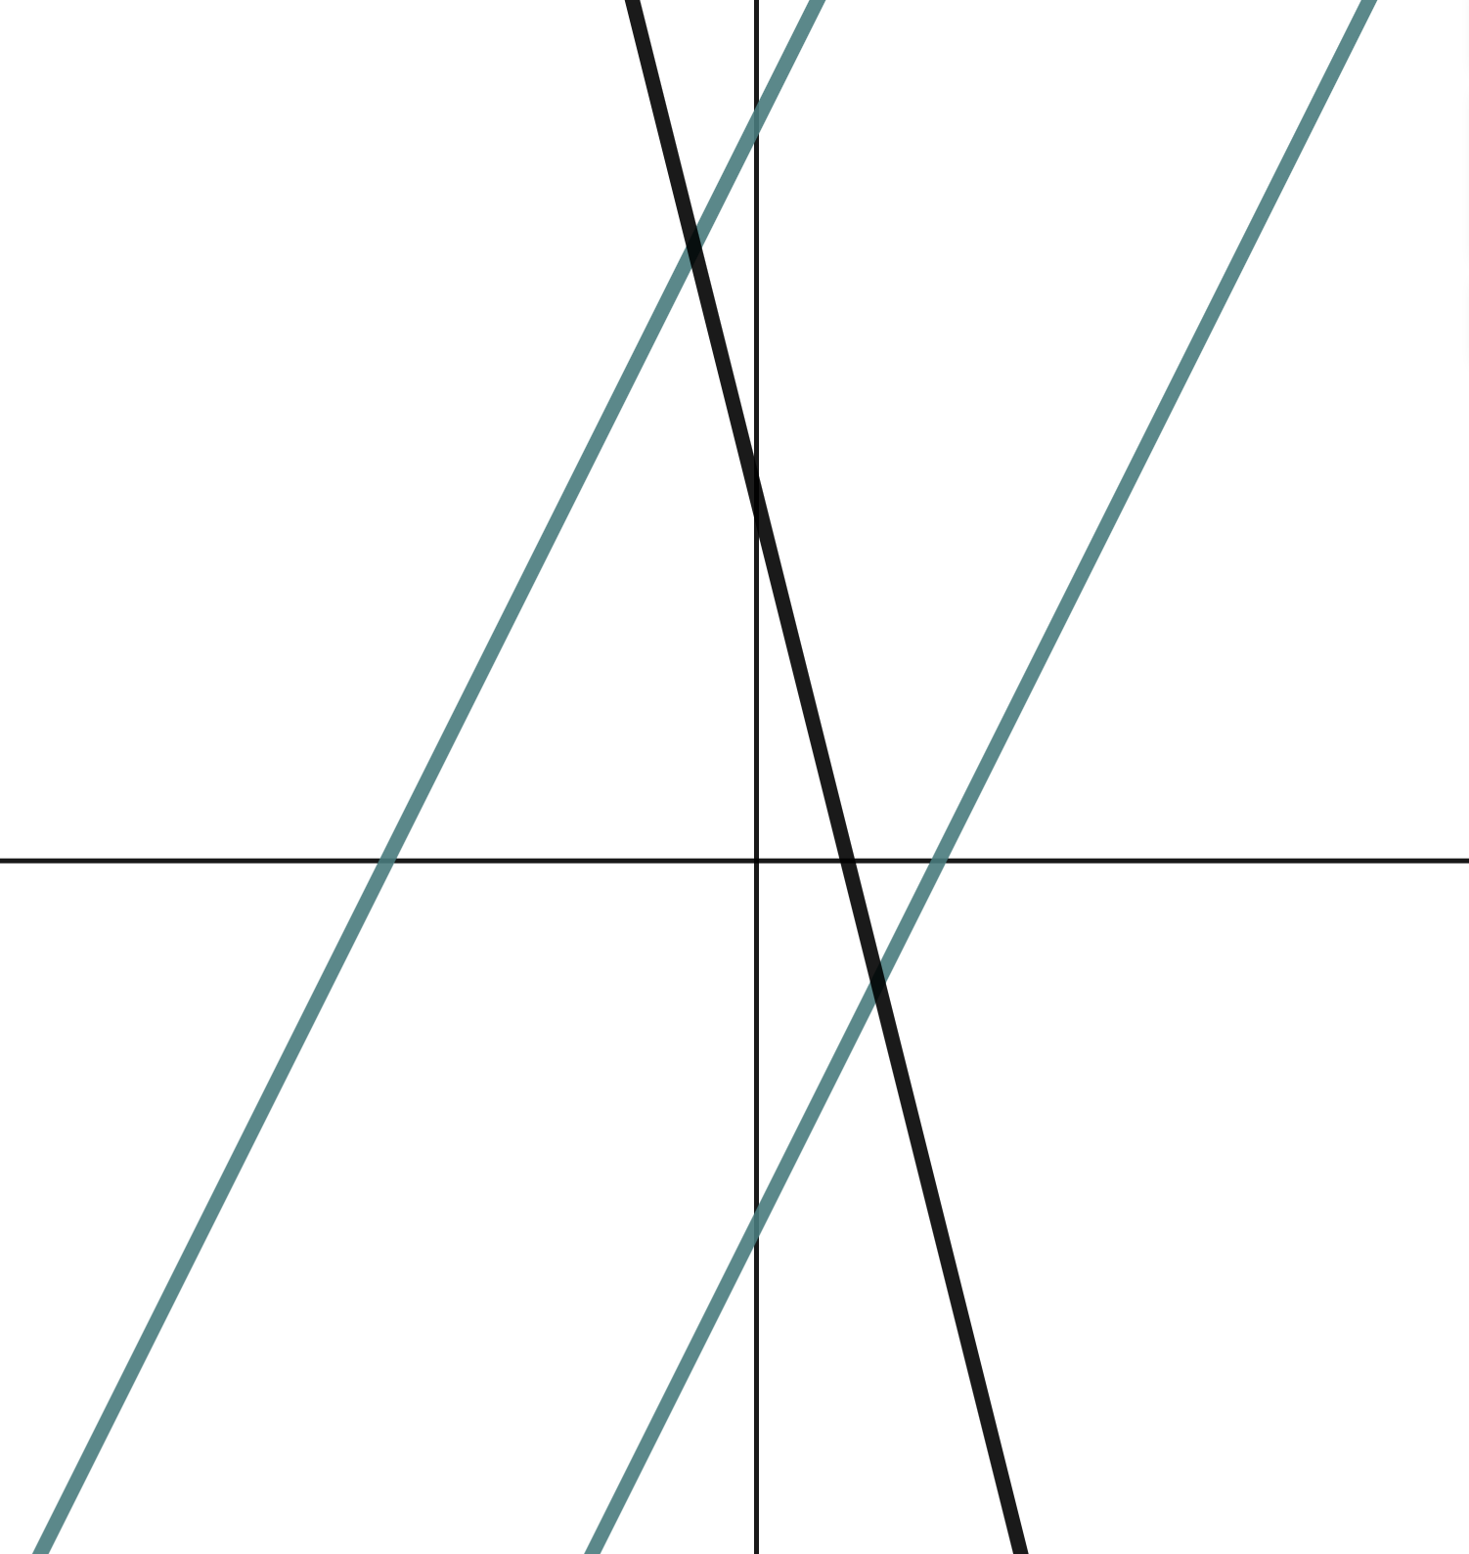
Sketching linear graphs
1) Sketch the lines y = 2x + 10, y = 5 − 4x, and y = 2x − 5 on the below axes.
y
y-intercepts should be labelled and (0, 10) should be twice as far from the origin as (0, 5)
✖
(0, 10)
(0,−5) should be the same distance from the origin as (0, 5)
(0, 5)
✖
y = 2x + 10 and y = 2x − 5 should have the same gradient therefore look parallel in your sketch.
x
(0,−5)
✖
y = 5 − 4x is a steeper gradient. This should be visibly obvious.

Slide 43
Sketching linear graphs
2) Match the linear equations to their respective lines.
a)
b) y = 18 − 2x
c) y = −5x + 18
d)
y
y
a)
x
x
b) y = 18 − 2x
d)
c) y = −5x + 18

Slide 44
Equations and their graphs
We can recognise the determining features of the shape of a graph from its equation.
For example, we know that with an x exponent of 1, the graph of the equation y = 8x + 23 will be a straight line with gradient 8 and y-intercept of (0, 23).

Slide 45

© Oak National Academy 2024.
Produced in partnership with Mathematics in Education and Industry.
Licensed on the Open Government Licence v3.0, except where otherwise stated. See Oak terms and conditions.

